Slide 1


SAP in the Cloud
Version 1.0, July 2015
Author Ross Hightower
Product SAP HANA Cloud Platform
Level Beginner
November 10, 2015
Focus
An overview of SAP Cloud prodcuts and the role of SAP HANA Cloud Platform
Public

Slide 2
SAP in the Cloud Table of Content
What is the cloud?
SAP Cloud Products
SAP HANA Cloud Platform

Slide 3
What is the Cloud?

Slide 4
An Analogy: Electrical Generation
Originally, companies generated their own electricity, maintaining electrical generation facilities
With the invention of AC, Samuel Insull (a protégé of Thomas Edison) believed that centralizing the generation of electricity and selling it as a commodity would be more efficient and lead to cheaper electricity
Most people disagreed believing that outsourcing the generation of electricity was risky
Thirty years after Insull established Commonwealth Edison Company, few companies maintained their own power plants

Slide 5
Cloud Computing
Cloud computing is simply the commoditization of computing resources
A confluence of trends have made it possible:
The commoditization of server hardware
High-speed, reliable and pervasive networks
Advances in hardware virtualization

Slide 6
Why Cloud Computing will follow the Electrical Generation Path
Reduced operating costs
Reliability
Lowering of entry barrier
Flexibility
Universal access

Slide 7
Cloud Options
Infrastructure as a Service (IaaS)
Provider manages hardware resources
Customer is responsible for installing and maintaining OS and applications
Platform as a Service (PaaS)
Provider manages hardware resources, operating system and application development platform
Customer develops custom applications
Software as a Service (SaaS)
Provider manages hardware, operating system and application
Customer provides customization of the application

Slide 8
Cloud Options
Private Cloud
Cloud that services only a single client
Often a cloud computing platform that is implemented within the corporate firewall, under the control of the IT department.
Public Cloud
Cloud services shared by multiple clients
Managed Cloud as a Service
Partner manages infrastructure as well as the software application

Slide 9
SAP Cloud Options

Slide 10
SAP Cloud Options
Infrastructure as a Service (IaaS)
SAP HANA Enterprise Cloud (HEC)
SAP HANA Infrastructure Services
SAP HANA DB Services
Platform as a Service (PaaS)
SAP HANA Cloud Platform (HCP)
Software as a Service (SaaS)
SuccessFactors, Concur, Ariba, Fieldglass, Hybris

Slide 11
SAP Cloud Offerings
(on-premise) Private Cloud (managed)
Public Cloud
Managed Cloud as a Service
Platform as a Service
Software as a Service
Customer Systems
SAP S/4HANA on-Premise
SAP Business Suite
SAP HEC
SAP HANA Cloud
Platform
S/4HANA Public Cloud
Core ERP SuccessFactors
Line-of-Business Feildglass
Hybris Concur
Cloud for Customer Ariba
New Applications
Extension Applications
Infrastructure/DB Services
SAP S/4HANA Private Cloud
SAP Business Suite
SAP BW
Any DB
SAP HANA

Slide 12
SAP HANA Cloud Platform

Slide 13
SAP HANA Cloud Platform
SAP HCP provides a platform for creating custom applications and extensions to other SAP products
It provides:
Runtime containers that allow development of Java and HTML5 applications
Connectivity service allows secure connections to on-premise and third-party services
SAP HANA Cloud Portal allows the creation of portals that aggregate content from SaaS applications, extension apps and third-party applications.
Interfaces that exchange data between on-premise and cloud systems
Allows development of custom mobile applications that access on-premise and cloud systems.

Slide 14
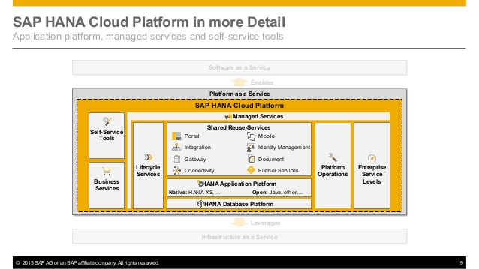

Slide 15
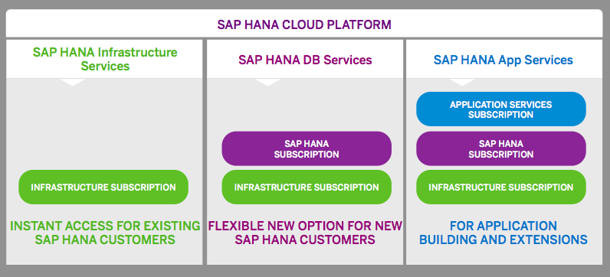
HANA Cloud Platform

Slide 16
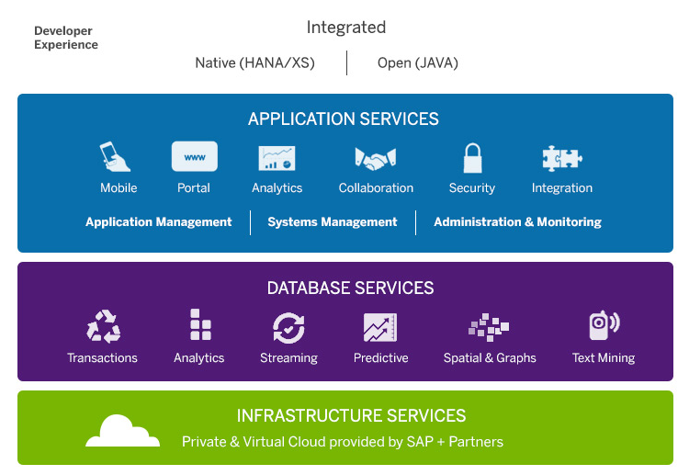
SAP HCP Services

Slide 17
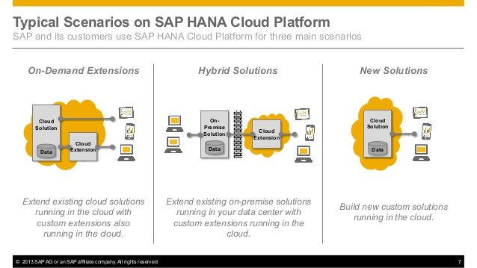

Slide 18
Thank you
Contact information:
Ross Hightower
Director SAP UCC
University of Wisconsin-Milwaukee

